Slide 1

Azure SQL Database Business Continuity

Slide 2







Jes Schultz (she/her)
Runner
Foodie
Program Manager @ Microsoft
Based in Louisville, KY
@grrl_geek
Jes Schultz
grrlgeek

Slide 3

Data is the most important asset for most organizations.
If they lose access to their data, or the data itself, they lose business.
One way to mitigate this threat is through a business continuity plan

Slide 4

What's Business Continuity?
"A process-driven approach to maintaining operations in the event of an unplanned disruption."

Slide 5
Core concepts
Backups
A database backup is a transactionally-consistent record of the database at a point in time
Restores
A database restore takes a backup and recreates the database as of a point in time
HA (High Availability)
Recovering data within the same data center or region
DR (Disaster Recovery)
Recovering data in a secondary data center or region

Slide 6
In the on-premises SQL Server world...
DBAs set up backup jobs
Hopefully they test restores
They may set up Windows Server Failover Clustering (WSFC) with SQL Server Failover Cluster Instances (FCI) (shared storage), or Always On Availability Groups (AGs) (separate storage) for HA.
They may set up Availability Groups or Log Shipping for DR.

Slide 7

That's a lot of work
...especially when a company has hundreds of SQL Server instances.

Slide 8
Azure makes it easier!
Azure SQL Database does heavy lifting for the DBA
Notes:
NOTE: this presentation focuses on Azure SQL Database – single DB/elastic pools. It will not cover SQL VMs in Azure or SQL Managed Instance.

Slide 9
Backups
Taken regularly
Full backup every week
Differential backups every 12 or 24 hours
Transaction log backups approximately every 10 minutes - based on compute size and database activity
*Hyperscale uses storage snapshots
Redundant
By default, backups are stored in blob storage in the database region and replicated to a paired region

Slide 10
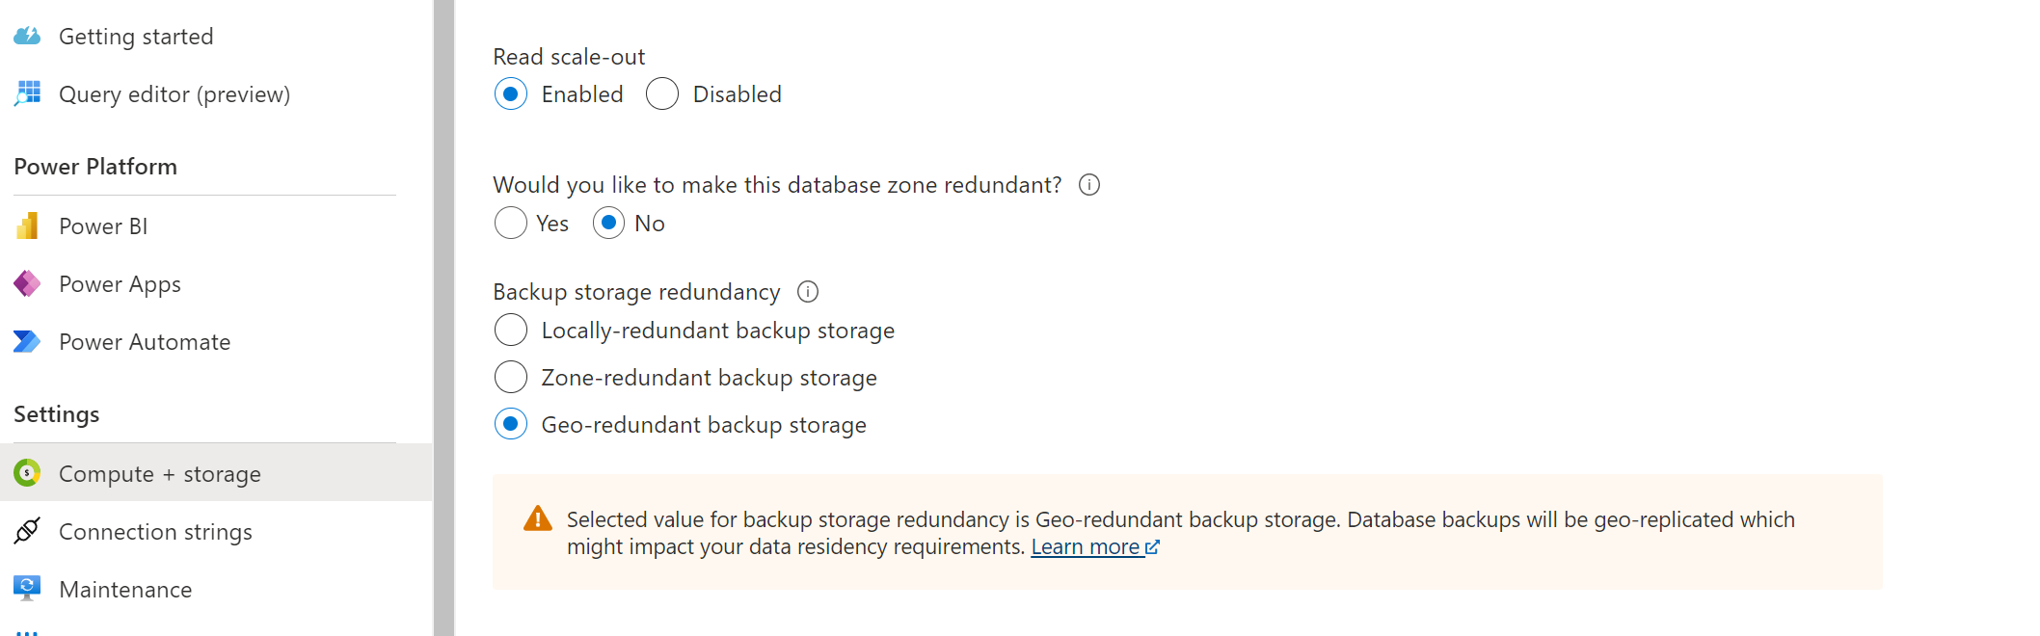

Slide 11
Restores
Easy button - no more figuring out which series of backups to restore
Go to portal, PowerShell, or CLI and specify the name of the database and the day and time to restore to

Slide 12
Demo
Point-in-time restore
Notes:
Portal – go to SQL server jeschult > Backups > Demo003 > Restore. Restore to one day earlier, on same server.
Portal – go to SQL Database Demo003 > Overview, show Restore button, same options.
CLI – open VS Code – open Restore database – CLI.azcli, godspeed and good luck

Slide 13
High Availability
Built in – customers don’t get to customize in Azure
Notes:
https://docs.microsoft.com/en-us/azure/azure-sql/database/high-availability-sla?view=azuresql&tabs=azure-powershell

Slide 14
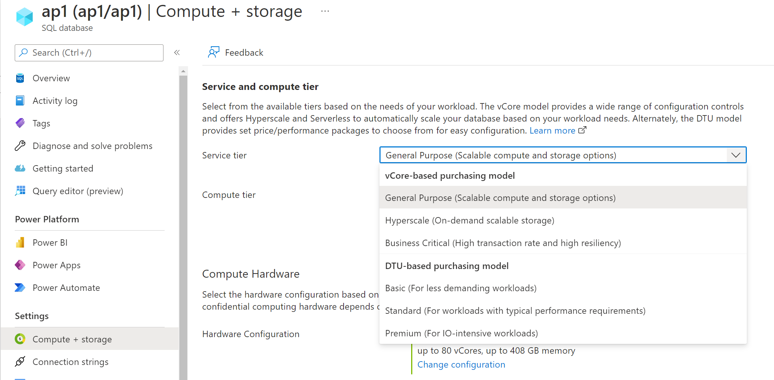

Slide 15
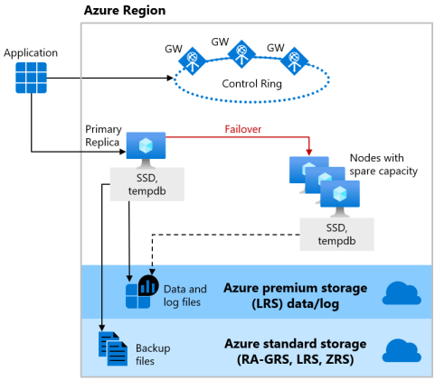
General Purpose (Basic, Standard)
Separate compute and storage
The high availability is at the storage level
During failover, a new stateless compute replica is created and data and log files are attached to it
Slower failover because the new compute node must start the sqlservr.exe process with a cold cache

Slide 16
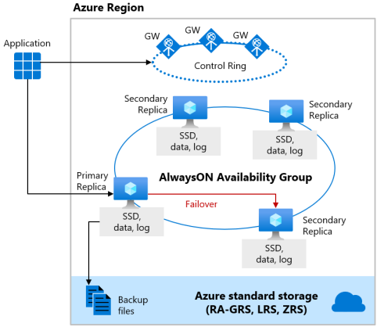
Business Critical (Premium)
Integrated compute and local SSD storage in a cluster
At least three nodes exist in the same region
During failover, primary fails over to a fully-synchronized secondary
Faster failover because compute is already provisioned, and data is in sync
Notes:
Understanding and leveraging Azure SQL Database’s SLA | Azure Blog and Updates | Microsoft Azure

Slide 17
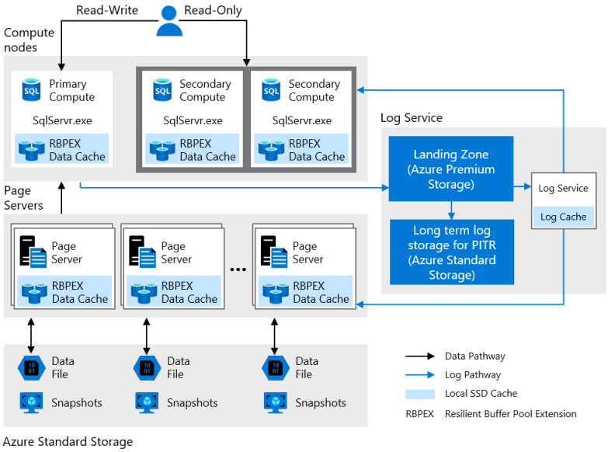
Hyperscale
4 layers of redundancy
Compute
Can have multiple as failover targets
Page Server storage
Every page server has an active-active paired server
Transaction Log storage
Uses Azure Storage for availability and redundancy
Database file storage
Uses Azure Storage for availability and redundancy

Slide 18
Availability Zones
By default, all compute nodes and data storage are provisioned in the same datacenter in one region
Availability Zones (new, still in preview for Hyperscale) allow the compute and storage to be provisioned across multiple data centers in the same region
Reduces single point of failure during an outage or disaster
Helps companies that need to follow data residency laws achieve HA and some level of DR without going outside of their boundaries

Slide 20
What else DBAs and devs need to know
The database can and will be failed over automatically between HA replicas for patching and maintenance.
All apps need to have retry logic built in.

Slide 21
Disaster Recovery
Customers can configure this!

Slide 22
Active geo-replication
Set up at SQL Database level – one database at a time
Create up to four readable secondary databases in different region(s)
Asynchronous replication from primary to secondaries
Failover: manual
On failover, update application connection string to new server name
Notes:
https://docs.microsoft.com/en-us/azure/azure-sql/database/active-geo-replication-overview?view=azuresql

Slide 23
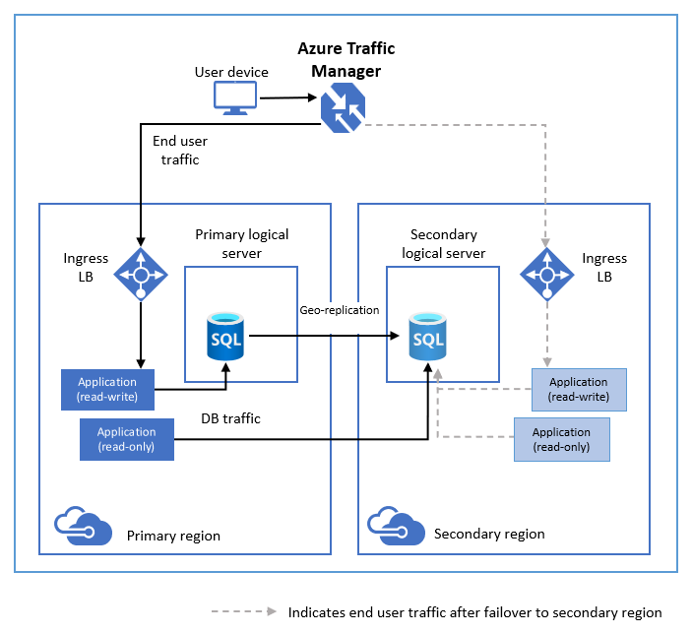

Slide 24
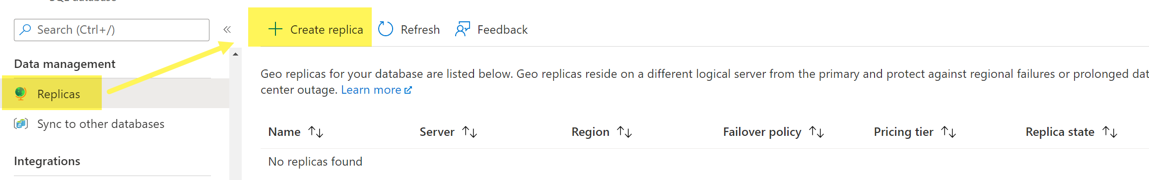
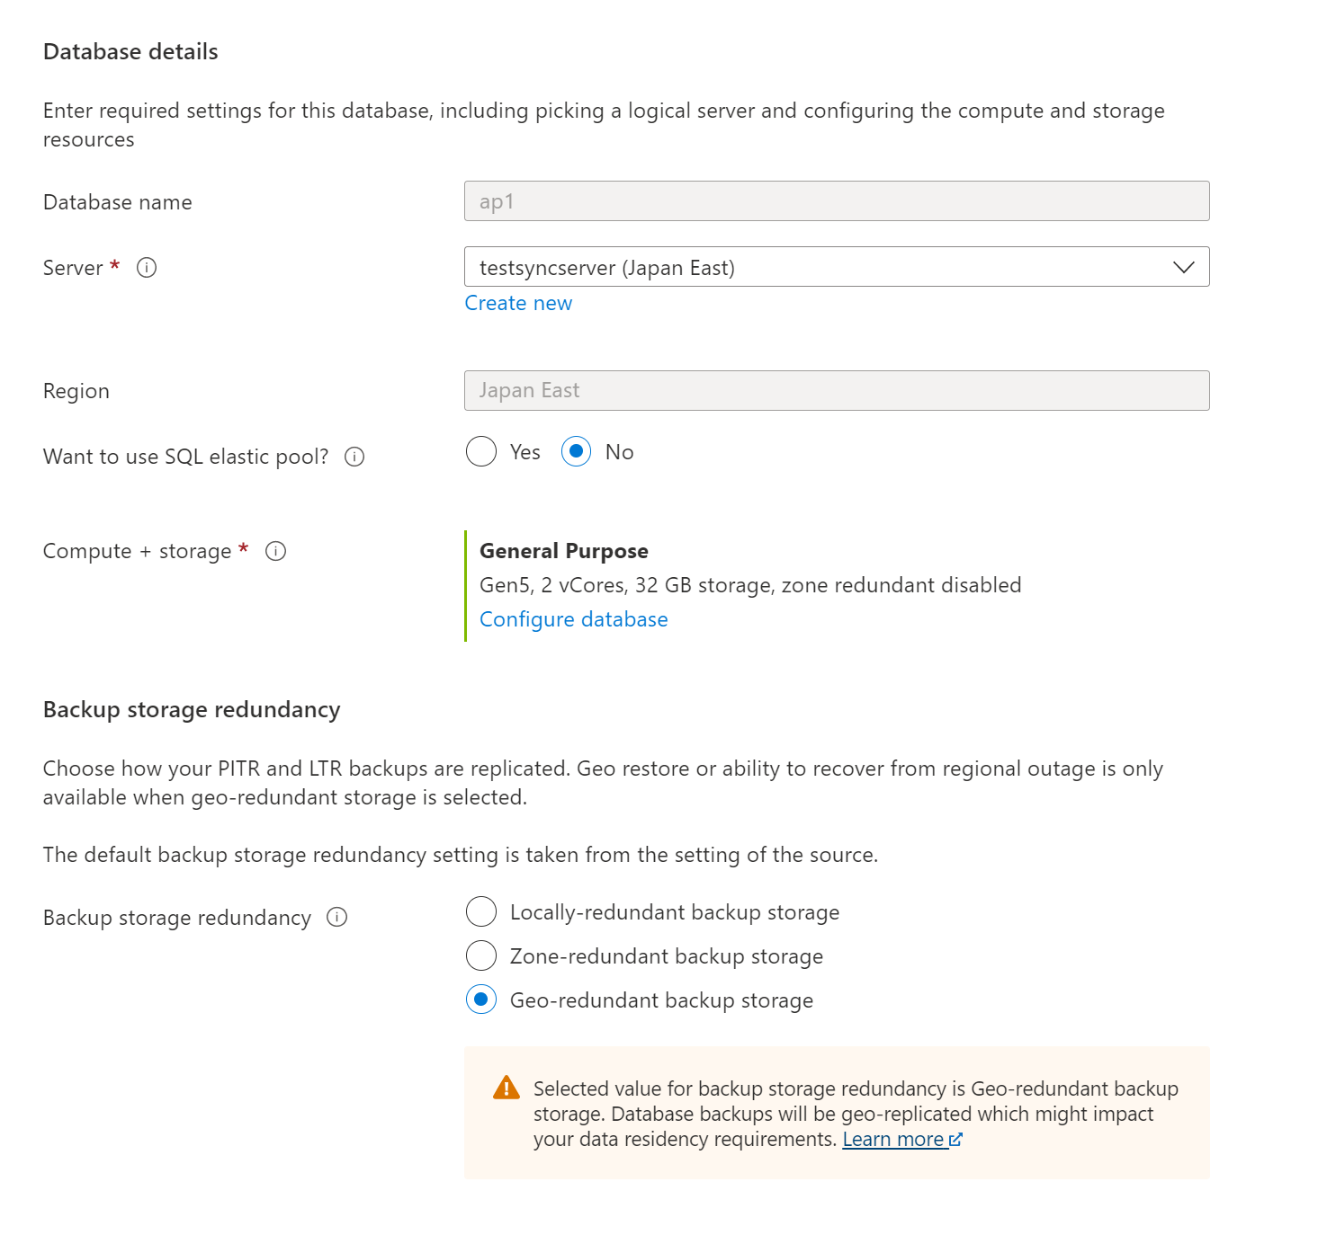

Slide 25
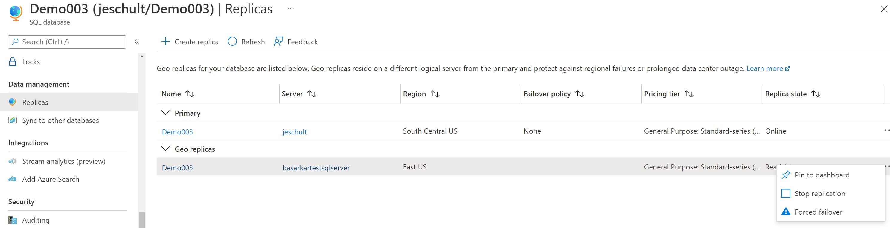

Slide 26
Demo
Active geo-replication
Notes:
Portal – go to Demo003 > Replicas. Click “Create replica”, walk through

Slide 27
Why choose active geo-replication?
The app has one database
The app can benefit from one or more readable secondary replicas
The RTO is high enough to allow for manual failover to the replica and time to update the connection string

Slide 28
Failover groups
Abstraction of geo-replication
Set up at SQL server level!
One or more databases in a group
Readable secondaries behind a load balancer with a listener
Can have a read-write listener or read-only listener
Failover: automatic or manual
On failover, if application is directed to listener name, no need to update connection string
If automatic is chosen, you can set a "grace period", which determines how long the system waits before initiating failover. This potentially reduces data loss.

Slide 29
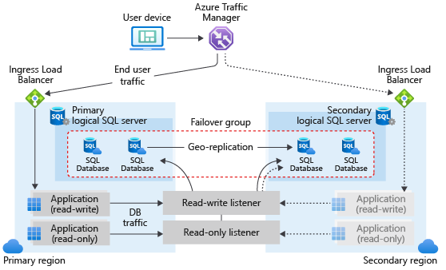

Slide 30
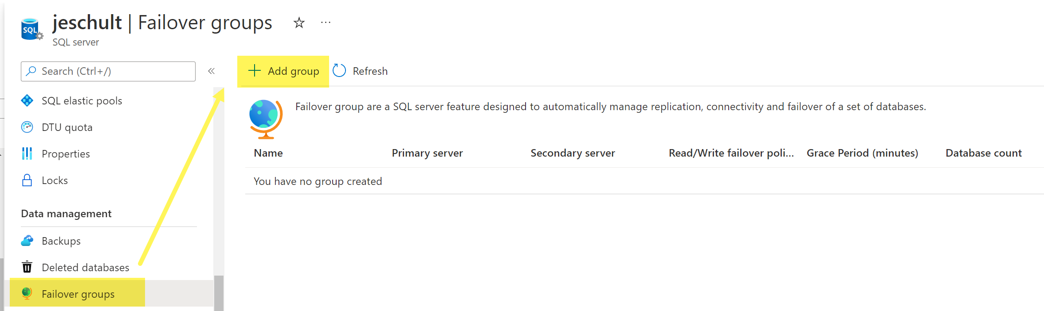
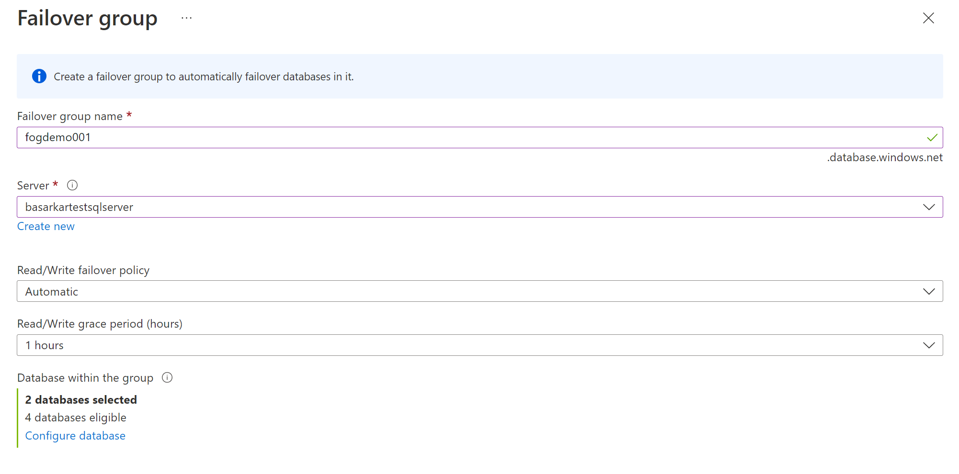

Slide 31
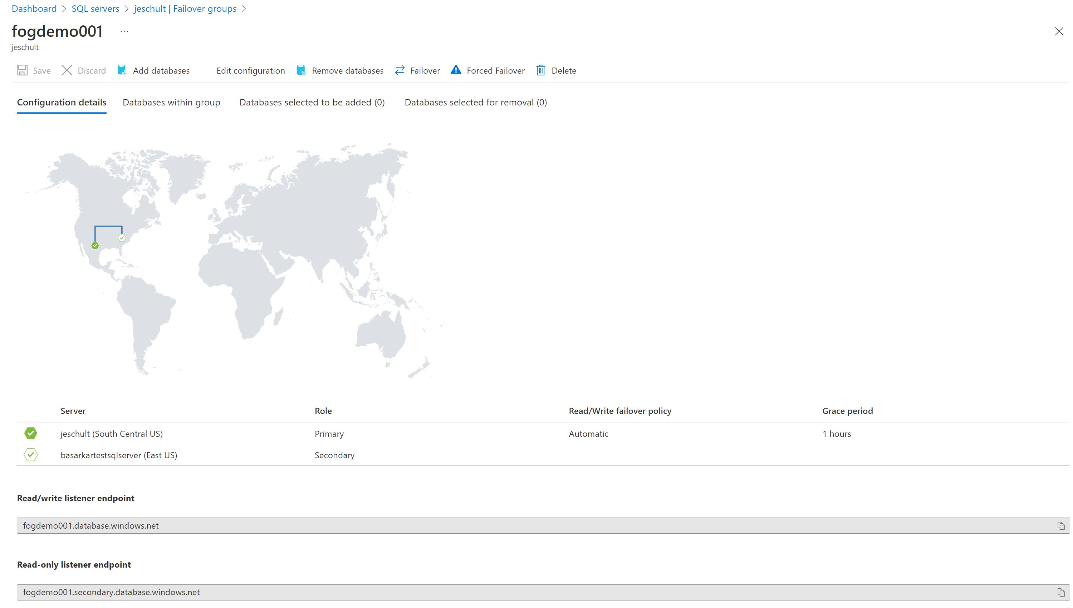

Slide 32
Demo
Failover groups
Notes:
Portal - Go to jeschult > Failover Groups > fogdemo002.
Show tabs – Configuration, DBs, Selected…
Click “Failover”

Slide 33
Why choose failover groups?
App has multiple databases that need to fail over together
The RTO is low enough that failover must be automatic and the connection string can’t be updated manually

Slide 34
Recap
Backups
Azure SQL Database automatically takes backups
Restores
Azure SQL Database restores are simple – provide the date and time you want to restore to
HA (High Availability)
HA is built into every tier of Azure SQL Database
DR (Disaster Recovery)
Active geo-replication for a single database
Backups are stored in multiple regions
Failover groups at the SQL server level for multiple databases

Slide 35

Questions?

Slide 36
Resources
Automatic, geo-redundant backups - Azure SQL Database | Microsoft Learn
Restore a database from a backup - Azure SQL Database | Microsoft Learn
Active geo-replication - Azure SQL Database | Microsoft Learn
Auto-failover groups overview & best practices - Azure SQL Database | Microsoft Learn
Disaster recovery drills - Azure SQL Database | Microsoft Learn

